Slide 1
Broadening the Lens of Serious Mental Health Health: The Impact of Trauma
Alexander Threlfall, MD
Chief of Psychiatry
Santa Cruz County Behavioral Health

Slide 2
Why is it important to think about trauma when thinking about SMI?

Slide 3
Trauma is an integral part of our daily interaction with patients.
Physical or sexual abuse in childhood is reported by approximately 20% to 50% of adults
Up to 70% of patients with depression, irritable bowel, chronic pain, or substance abuse reported childhood physical or sexual abuse
Springer et al.; J GEN INTERN MED 2003;18:864–870

Slide 4
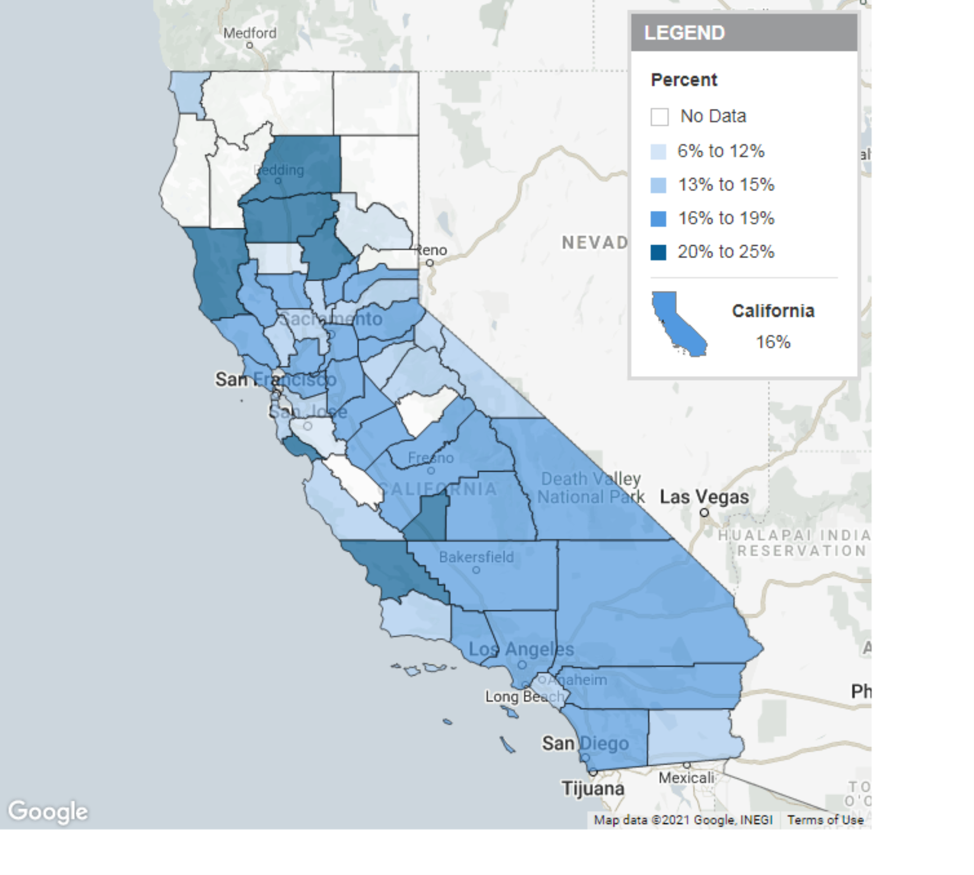
Prevalence of Adverse Childhood Experiences (Adult Retrospective): 2011-2017; Showing Counties
(Number of ACEs: 4 or More ACEs; Household Type: All Households)
Definition: Estimated percentage of adults with and without adverse childhood experiences (ACEs) before age 18, by presence of children in the household and number of ACEs (e.g., among California adults ages 18 and older living in households with children in 2011-2017, 17% were exposed to four or more ACEs).
Data Source:As cited on kidsdata.org,UC Davis Violence Prevention Research Program, tabulation of data from the California Behavioral Risk Factor Surveillance System and American Community Survey (Apr. 2020).

Slide 5
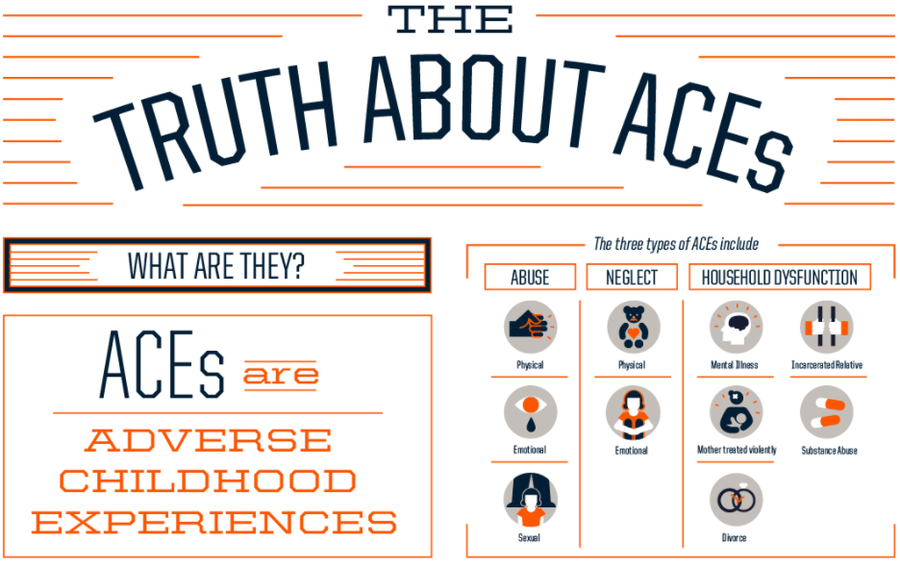

Slide 6
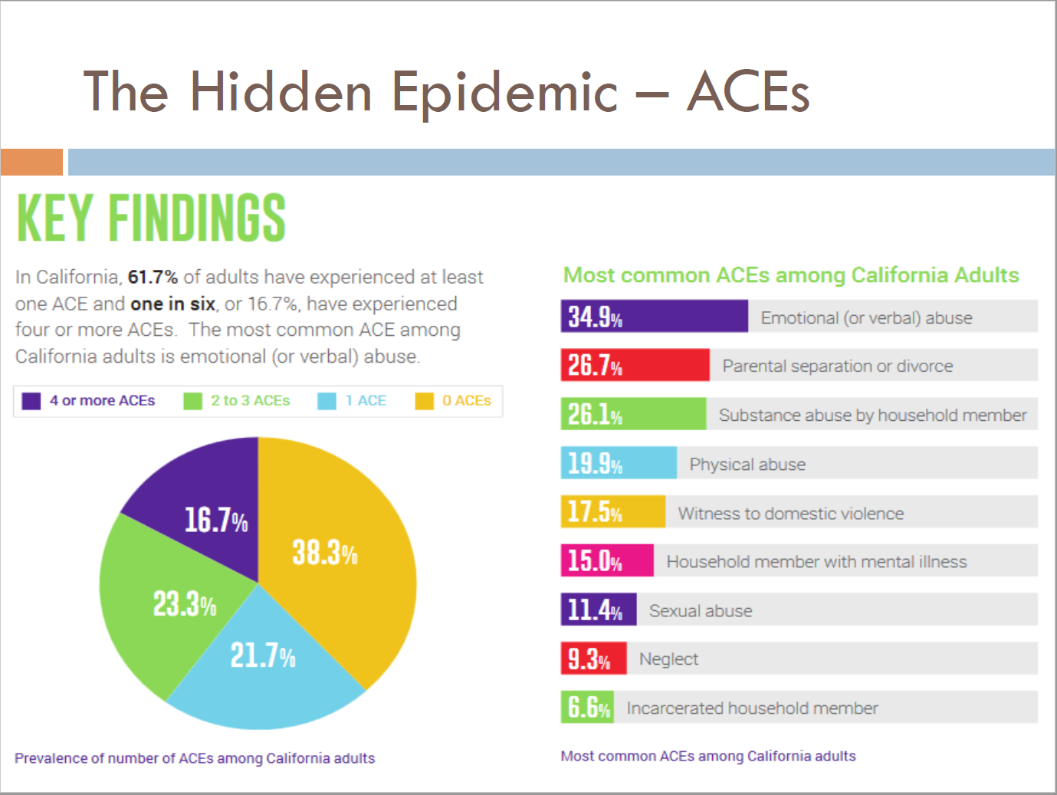

Slide 7
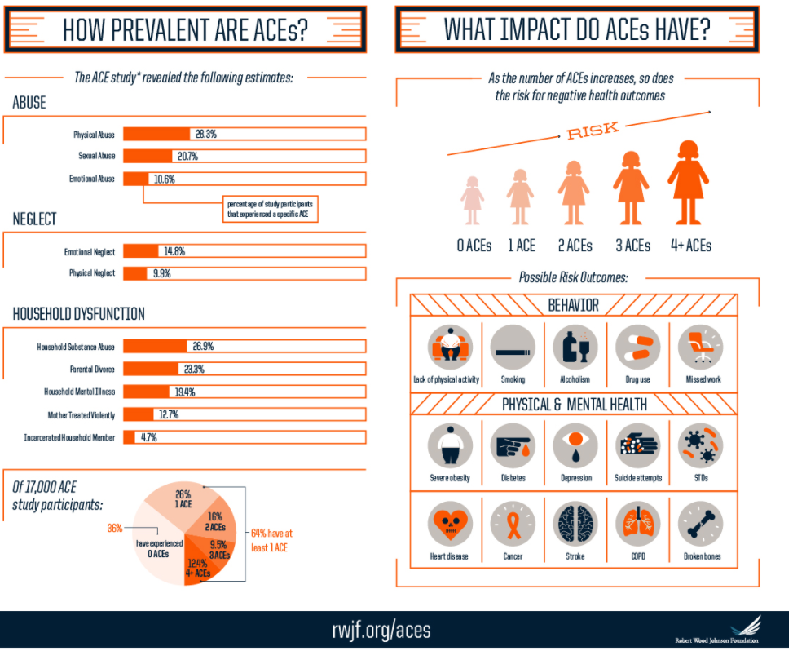

Slide 8
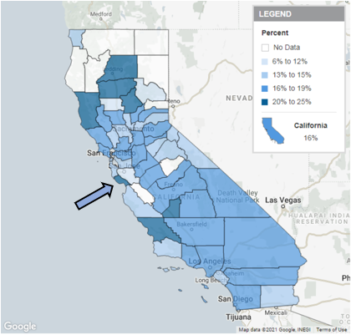

Slide 9
Prevalence of Adverse Childhood Experiences (Adult Retrospective): 2011-2017; Showing Counties
(Number of ACEs: 4 or More ACEs; Household Type: All Households)
Definition: Estimated percentage of adults with and without adverse childhood experiences (ACEs) before age 18, by presence of children in the household and number of ACEs (e.g., among California adults ages 18 and older living in households with children in 2011-2017, 17% were exposed to four or more ACEs).
Data Source:As cited on kidsdata.org,UC Davis Violence Prevention Research Program, tabulation of data from the California Behavioral Risk Factor Surveillance System and American Community Survey (Apr. 2020).

Slide 10
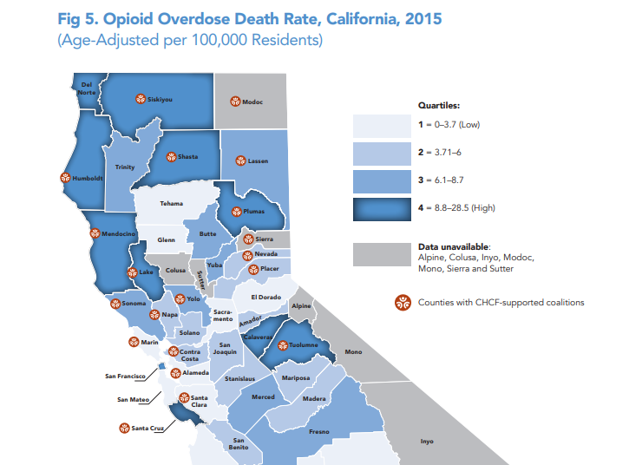
http://www.phi.org/wp-content/uploads/migration/uploads/application/files/bt93oju0nrnbsmjhpdw692ljgu0d27ttdpzxmbclj7cxq99alz.pdf

Slide 11
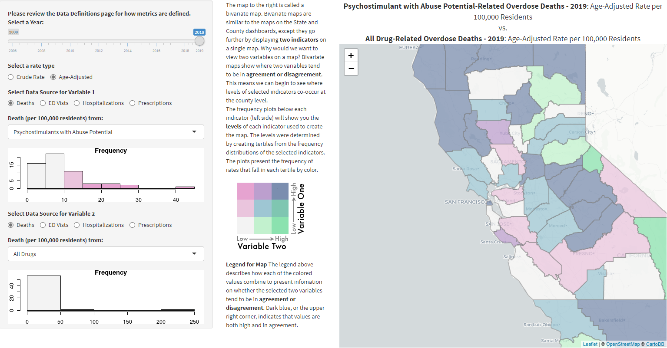
https://skylab.cdph.ca.gov/ODdash/

Slide 12
Reconceptualizing Psychosis in the Context of Trauma
Understanding the Impact of Developmental Trauma
Neglect and emotional abuse in 33-59% of patients experiencing psychosis
Associated with positive and negative symptoms
1/3 of all cases of psychosis attributable to childhood trauma
ACES Score: 0 v 7+ = 5-fold increase in the risk of reporting hallucinations
Increase risk of 1.2 to 2.5x by any one ACE
Bloomfield, Michael AP, et al. "Trauma-informed care for adult survivors of developmental trauma with psychotic and dissociative symptoms: a systematic review of intervention studies." The Lancet Psychiatry 7.5 (2020): 449-462.
Whitfield, Charles L., et al. "Adverse childhood experiences and hallucinations." Child abuse & neglect 29.7 (2005): 797-810.

Slide 13
Reconceptualizing Psychosis in the Context of Trauma
Adult Survivors of Developmental Trauma Who Experience Psychosis
Higher risk of poorer prognostic outcomes
Greater sx severity
Higher rate of hospitalizations
Poorer response to tx
Increased doses of APs and mood stabilizers
Bloomfield, Michael AP, et al. "Trauma-informed care for adult survivors of developmental trauma with psychotic and dissociative symptoms: a systematic review of intervention studies." The Lancet Psychiatry 7.5 (2020): 449-462.

Slide 14
Reconceptualizing Psychosis in the Context of Trauma
Adult Survivors of Developmental Trauma Who Experience Psychosis
History of developmental trauma is lacking in routine assessments within mental health with one lit-review finding less than one‐third (28%) of abuse and neglect identified by researchers had been documented in clients’ MH files
Read, John, et al. "Do adult mental health services identify child abuse and neglect? A systematic review." International Journal of Mental Health Nursing 27.1 (2018): 7-19.

Slide 15
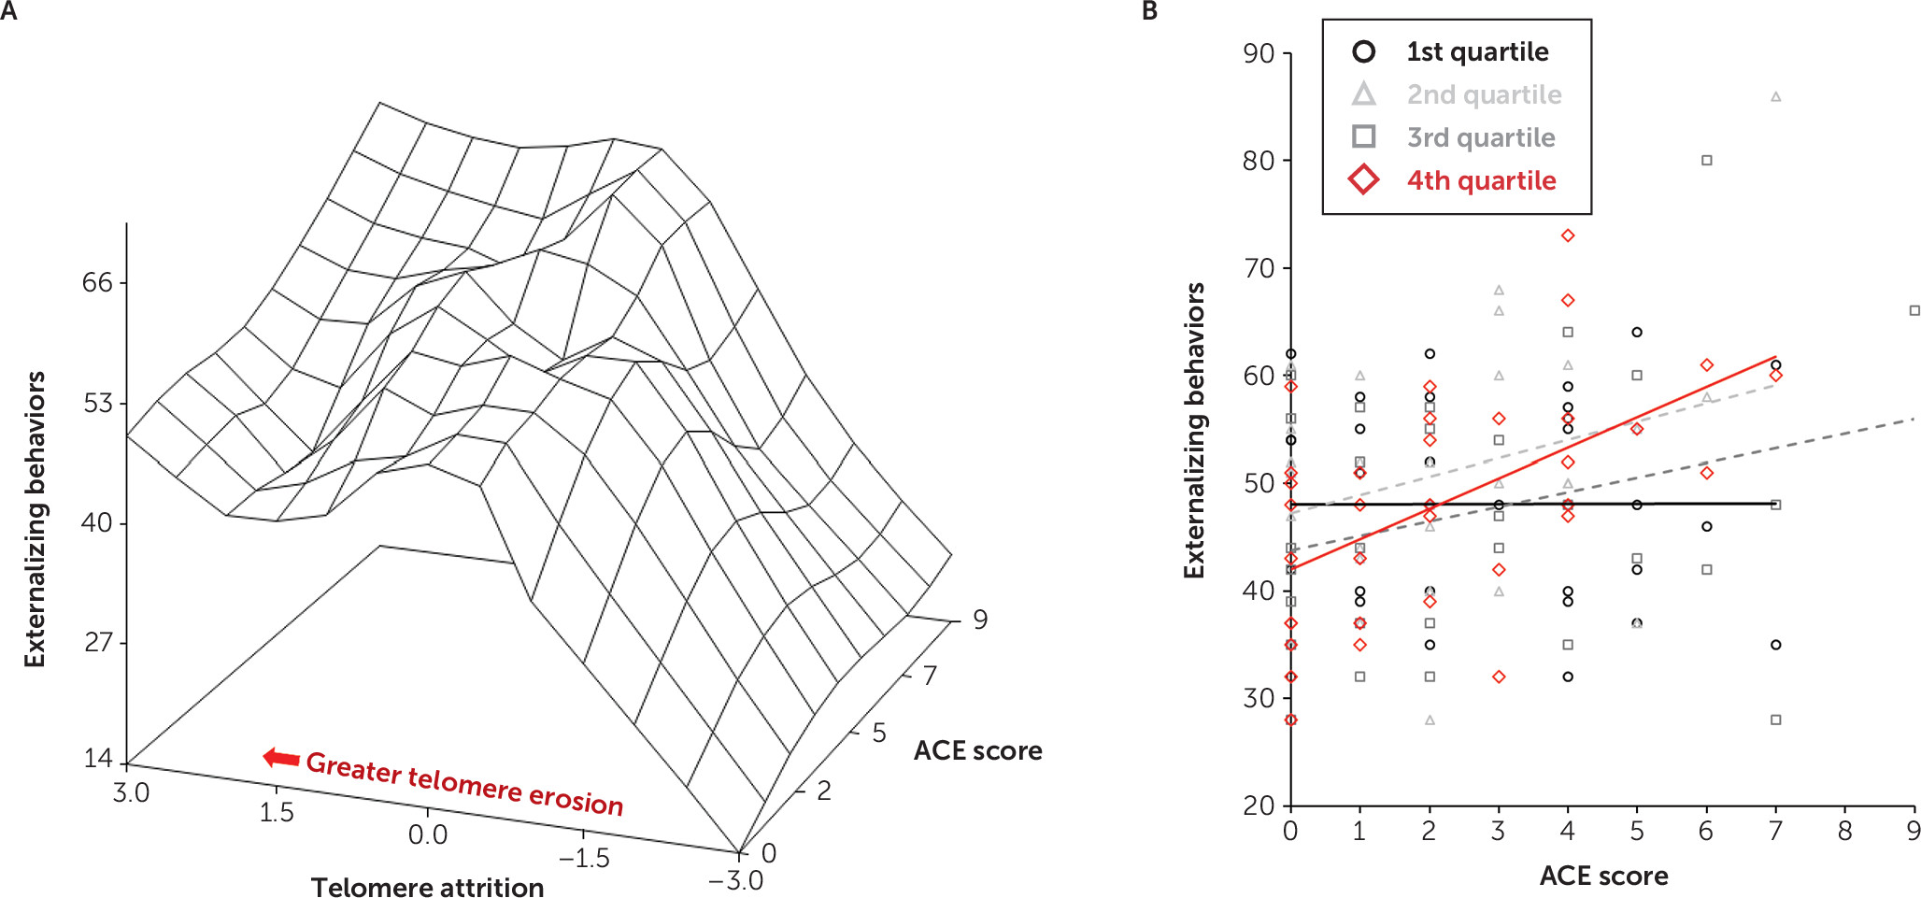
From: Adverse Childhood Experiences: Implications for Offspring Telomere Length and Psychopathology
American Journal of Psychiatry
a Panel A shows a surface plot of the moderation of maternal Adverse Childhood Experience questionnaire (ACE) score and externalizing behavior by telomere attrition. A spline interpolation was used to smooth the surface plot. Telomere attrition was defined as the difference in the 4-month telomere length (TL) from the 18-month TL (i.e., telomere attrition=4-month TL − 18-month TL). Panel B shows where telomere attrition was partitioned into quartiles in which the least amount of telomere attrition is represented by the first quartile (black), and the fourth quartile (red) represents the greatest amount of telomere attrition. For each quartile of telomere attrition, maternal ACE scores are plotted with externalizing behavior, and linear trend lines for each quartile are fitted to facilitate data visualization.
Date of download:
02/06/2021
Copyright © American Psychiatric Association. All rights reserved.
Esteves, Kyle C., et al. "Adverse childhood experiences: implications for offspring telomere length and psychopathology." American Journal of Psychiatry 177.1 (2020): 47-57.
Notes:
Externalizing behaviors: directing attention or maintaining attention on frustrating events or aggression
Telomere length: shorter length a/w decreased stress tolerance and other aspects of wellbeing/health

Slide 16
Dx Differential Challenging Due to Overlapping Symptoms of Trauma
Major Depressive Disorder w/ or w/o psychosis (avoidance/negative emotions: isolation, low motivation, anhedonia)
Bipolar Disorder (hyperarousal: insomnia, impulsivity, risk taking, mood instability)
Schizophrenia/affective disorder (avoidance: dissociation, distorted cognitions, hypervigilance)
Panic Disorder (intrusion: panic attacks from triggers)
GAD (negative emotionss/hyperarousal: insomnia, fear)
Agoraphobia (intrusion/avoidance: isolation, negative)
Specific phobia (intrusion/avoidance)
Adjustment disorder (multiple subclinical elements or of a lesser degree)
Acute Stress Disorder (same, but < 1 month)
Dissociative Disorders (avoidance: unconscious dissociation)
Factious disorders or malingering (secondary gain)

Slide 17
Treating psychosis in the context of trauma?
Evidence not supportive in the use of antipsychotics for the treatment of PTSD
Risperidone is no better than placebo in the treatment of PTSD
Cardiometabolic risks of antipsychotics use in PTSD is equal to or even higher than their use in other disorders

Slide 18
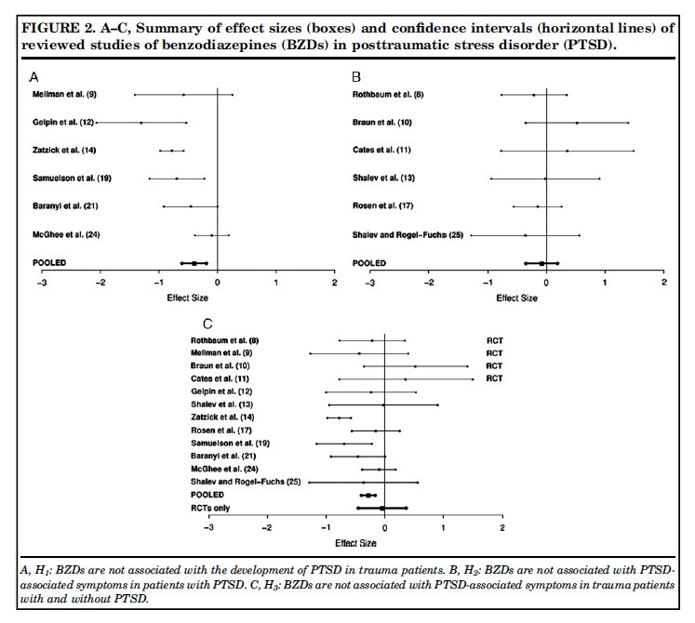
No evidence for benzodiazepines in trauma
Springer, K. W., Sheridan, J., Kuo, D., & Carnes, M. (2003). The long-term health outcomes of childhood abuse. Journal of General Internal Medicine, 18(10), 864-870.
Notes:
Conclude BZDs increase the likelihood of developing PTSD when taken by trauma patients.
Insufficient evidence that BZDs alleviate PTSD-associated symptoms when taken by patients who already have PTSD.
(POOLED) Conclude BZDs have an overall adverse impact in the prevention and treatment of PTSD.
C. (RTC’s) Conclude that there is no evidence that BZDs alleviate PTSD-associated symptoms in PTSD patients or prevent the development of PTSD in trauma patients.

Slide 19
Resources
Patients/Family/Friends/Providers
https://www.ptsd.va.gov/
Other Patient Education
https://www.nimh.nih.gov/health/publications/post-traumatic-stress-disorder-ptsd/index.shtml
https://www.nimh.nih.gov/health/publications/espanol/trastorno-por-estres-postraumatico/index.shtml

